Slide 1



Slide 2

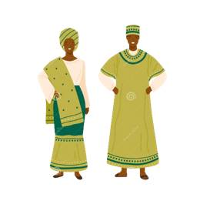
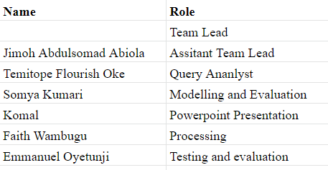

Our Team
Active Members
Name
Name
Project Lead
Name: Jennifer Nkiru Oreffo
Assistant Project Lead
Name: Jimoh Abdulsomad Abiola
Query Analysts
Name: Temitope Flourish Oke

Slide 3

Problem Statement
One of a nation's most valuable assets is its banknotes
To cause differences in the amount of money in the financial market, some criminals introduce fake notes that look like the actual notes
Humans find it challenging to distinguish between real and fake banknotes, in part because they have many characteristics
As fake notes are meticulously made, an effective algorithm that can predict whether a banknote is real or not is necessary

Slide 4
Existing Solutions
Swiss banknote counterfeit detection using naive-bayes-classifier
Swiss banknote counterfeit detection using svm-classifier
Swiss banknote counterfeit detection using neural-networks
Swiss banknote counterfeit detection using logistic-regression
Swiss banknote counterfeit detection using decision-tree-classifier
Swiss banknote counterfeit detection using k-means-clustering
Swiss banknote counterfeit detection using random-forest-classifier

Slide 5
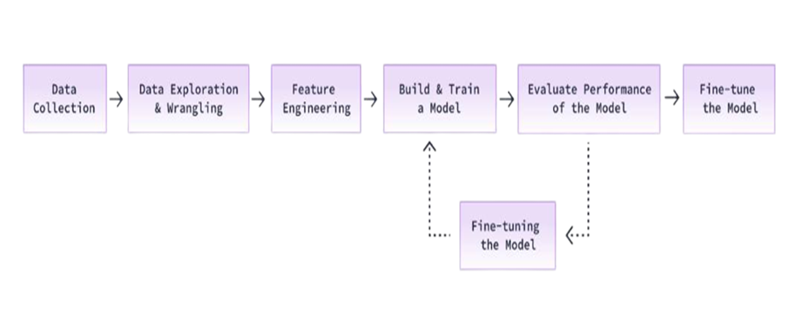
Our Approach
Flow Process

Slide 6
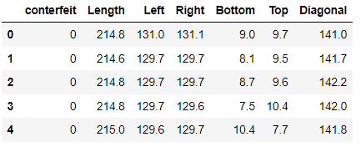
Dataset Description
We used near-perfect data for this problem sourced from Kaggle
The dataset is available here
The cleaned data from the exploratory data analysis (EDA) is used to design the machine learning model
The dataset includes information about the shape of the bill, as well as the label
It is made up of 200 banknotes in total, 100 for genuine/counterfeit each
Attributes:
counterfeit: Whether a banknote is counterfeit (1) or genuine (0)
Length: Length of bill (mm)
Left: Width of left edge (mm)
Right: Width of right edge (mm)
Bottom: Bottom margin width (mm)
Top: Top margin width (mm)
Diagonal: Length of diagonal (mm)

Slide 7
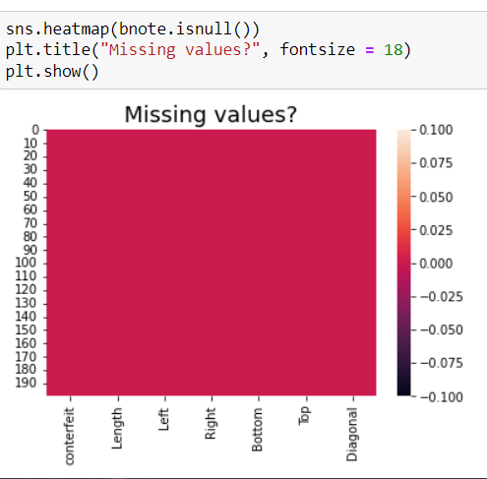
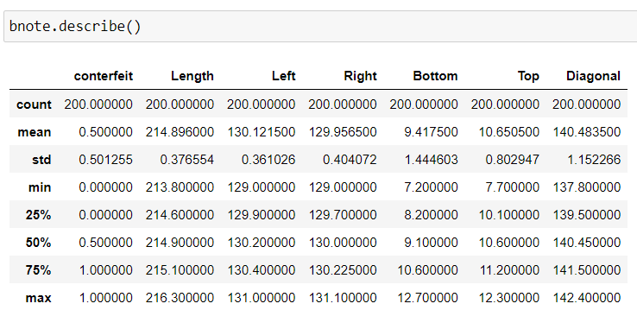
Data Exploration

Slide 8
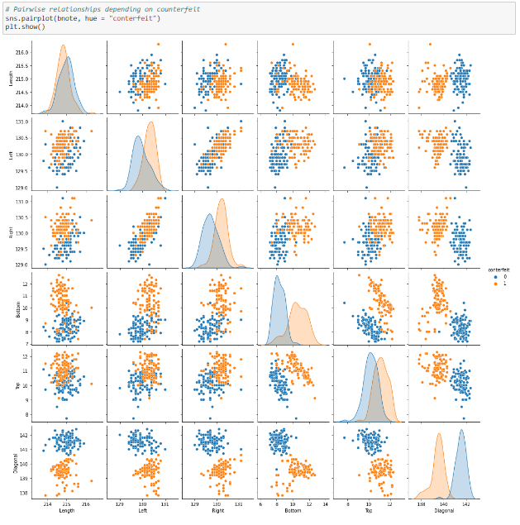
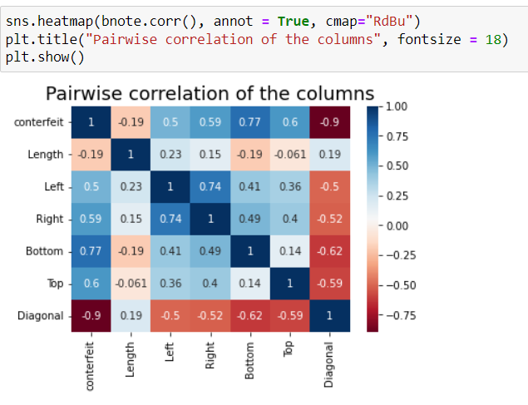
Data Wrangling

Slide 9
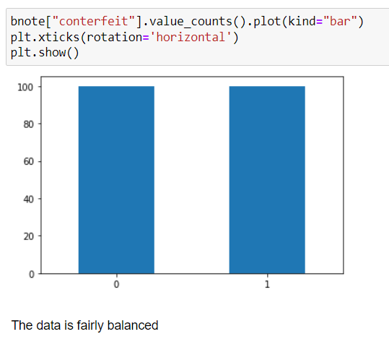
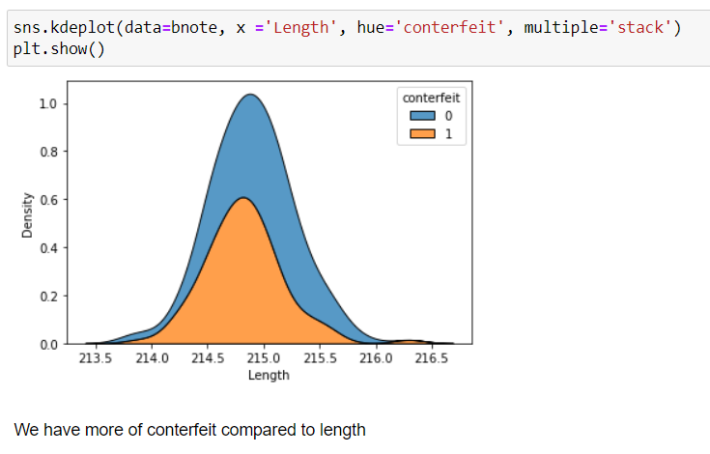
Data Wrangling

Slide 10
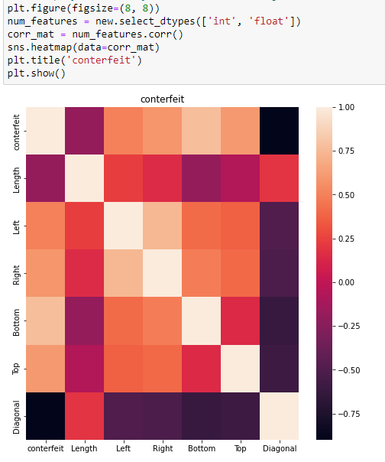
Feature Engineering
Heatmap of numerical feature in the training dataset

Slide 11
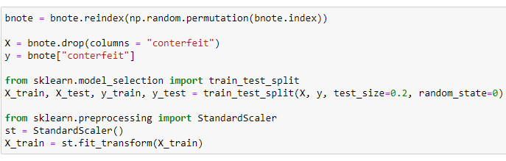
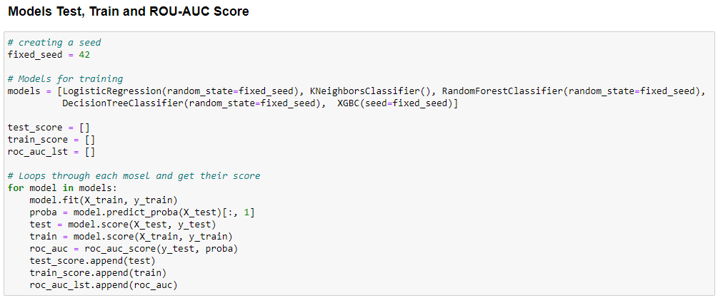
Build & Train the Model

Slide 12
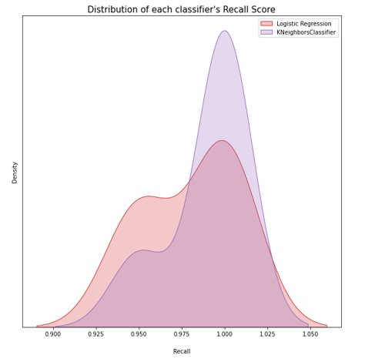
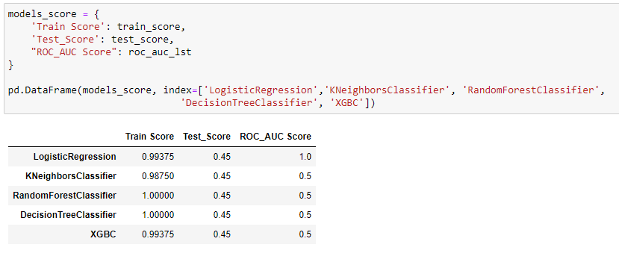
Build & Train the Model​

Slide 13
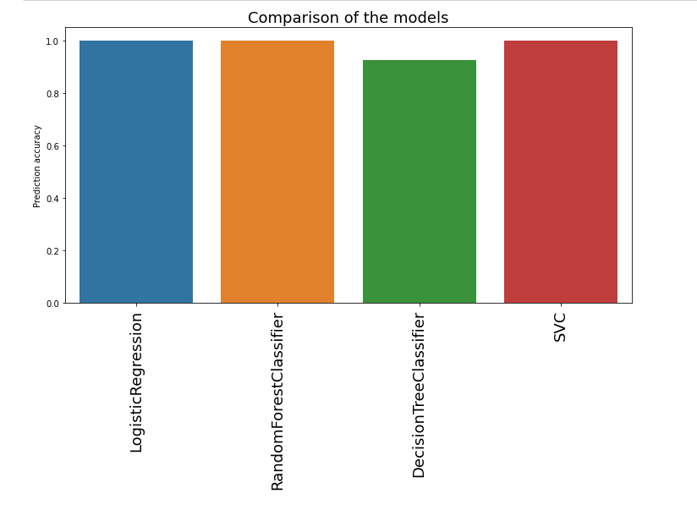
Build & Train the Model​

Slide 14
Build & Train the Model​

Slide 15
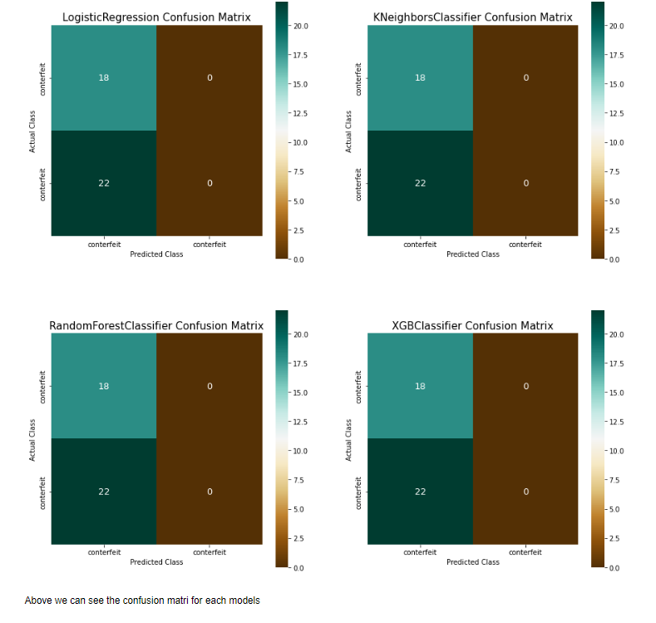
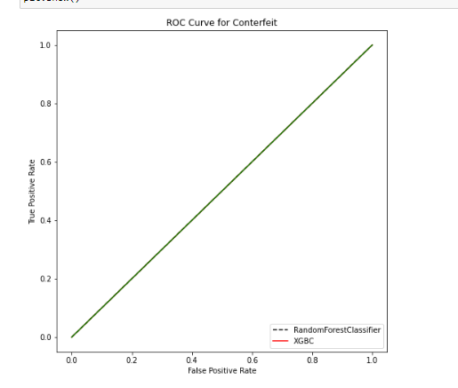
Build & Train the Model​

Slide 16
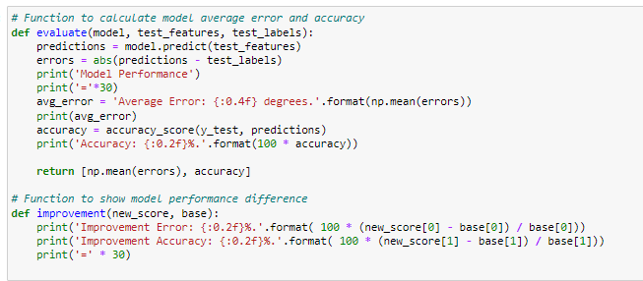
Evaluate Performance of the Model
This function was created to evaluate the performance of the model

Slide 17
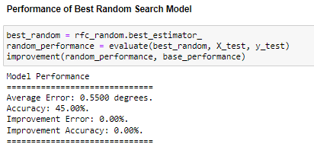
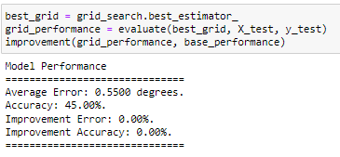
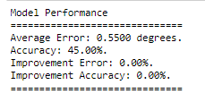
Fine-tune the Model
Hyper Parameter Tuning 1
Hyper Parameter Tuning 2
Hyper Parameter Tuning 3
A big decrease in performance, yet the same best parameters was given
This indicates we have reached diminishing returns for hyperparameter tuning
We could continue, but the returns would be the same output in terms of parameters

Slide 18
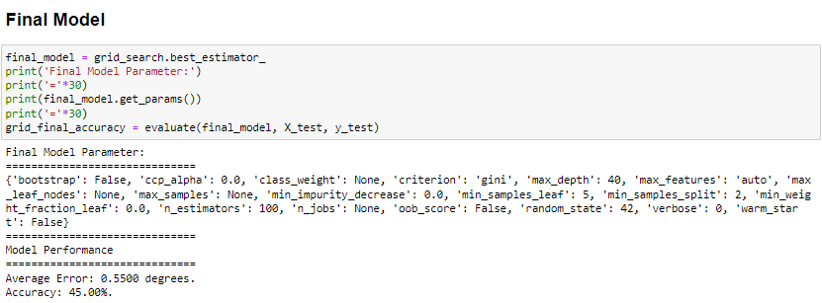
Final Model

Slide 19
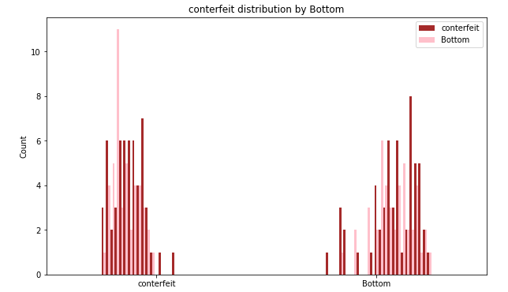
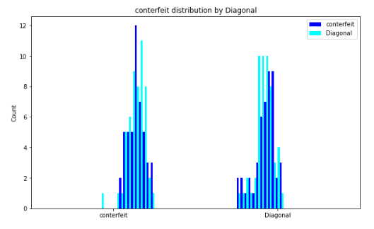
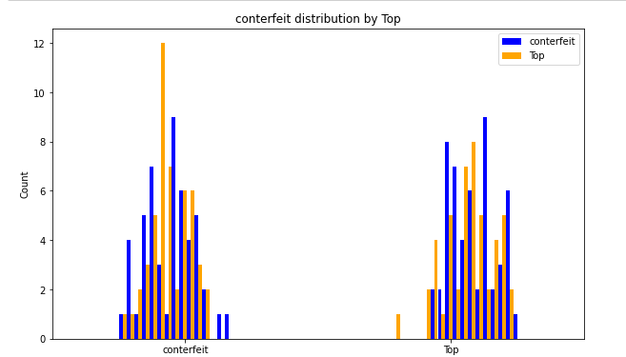
Summary
By using the results, we summarized the data and demonstrated some easy methods of analysis:
Simply employing diagonal variables has produced excellent classification results
Top and Bottom are two excellent variables to include in the predict model in order to categorize counterfeit banknotes

Slide 20
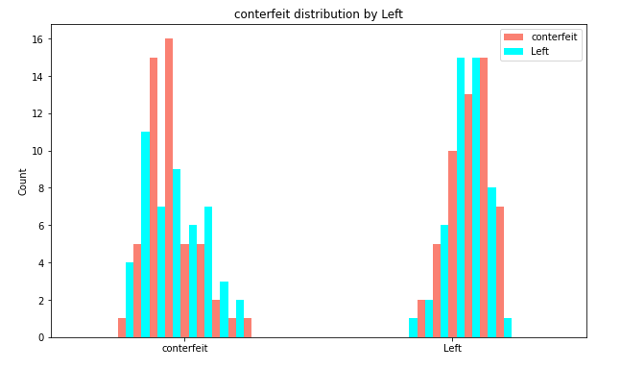
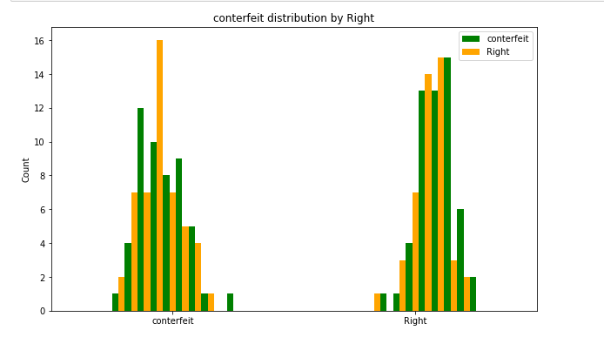
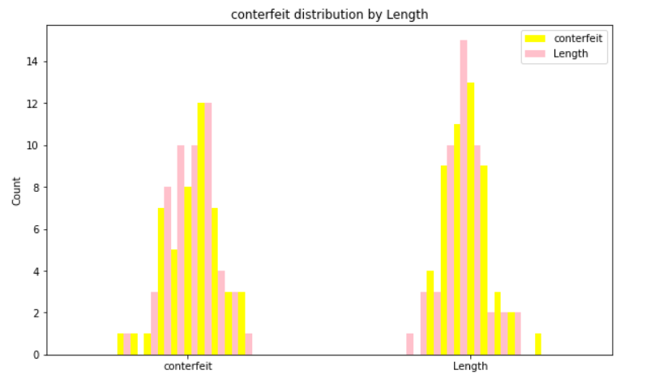
Summary

Slide 21
Limitations
No null values
Limited data

Slide 22


